Slide 1
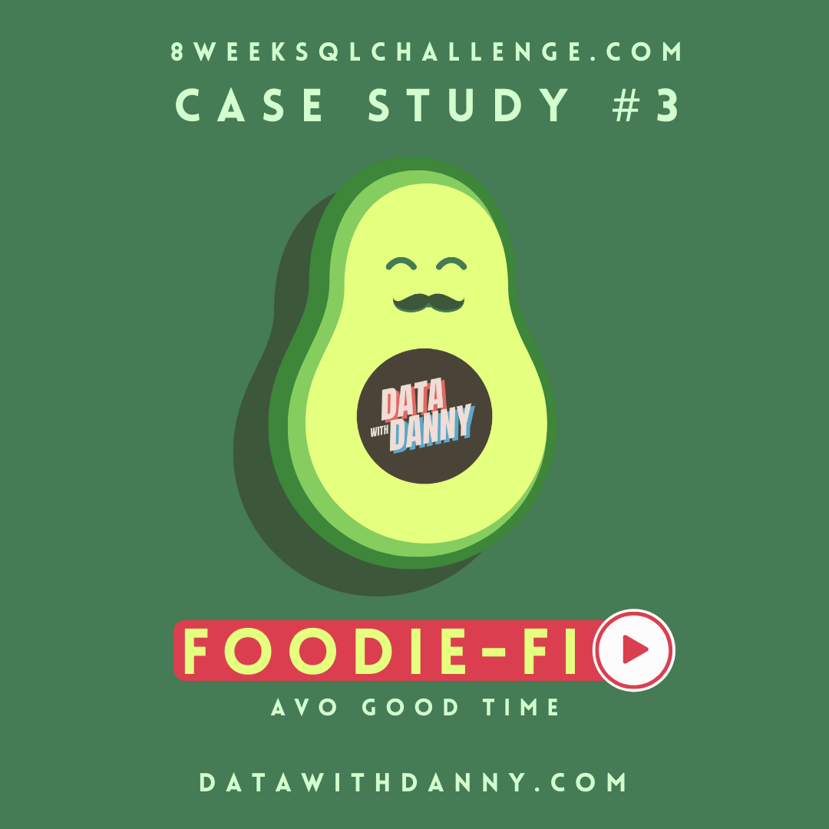
8 Week SQL Challenge
Case Study #3 - Foodie-Fi

Slide 2
Introduction
Subscription based businesses are super popular and Danny realised that there was a large gap in the market - he wanted to create a new streaming service that only had food related content - something like Netflix but with only cooking shows!
Danny finds a few smart friends to launch his new startup Foodie-Fi in 2020 and started selling monthly and annual subscriptions, giving their customers unlimited on-demand access to exclusive food videos from around the world!
Danny created Foodie-Fi with a data driven mindset and wanted to ensure all future investment decisions and new features were decided using data. This case study focuses on using subscription style digital data to answer important business questions.

Slide 3
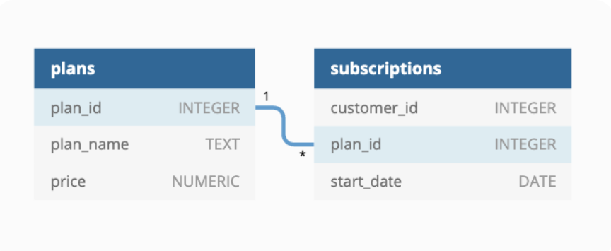
Entity Relationship Diagram

Slide 4
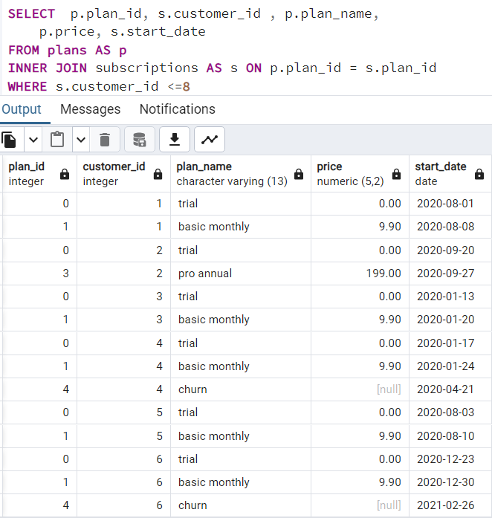
CASE STUDY A. Customer Journey
Based off the 8 sample customers provided in the sample from the subscriptions table, write a brief description about each customer’s onboarding journey.
Customer id 1 Starts a free trial on 2020-08-01 and post his free trial, which is for 1 week, he upgrades his plan to “basic monthly” starting 2020-08-08 for $9.90.
Customer id 2 Starts a free trial on 2020-09-20 and later upgrades to “pro annual” plan which costs $199.
Customer id 4 Starts a free trial on 2020-01-17 and upgrades to “basic monthly” plan on 2020-01-24 and then churns his plan on 2020-04-21.

Slide 5
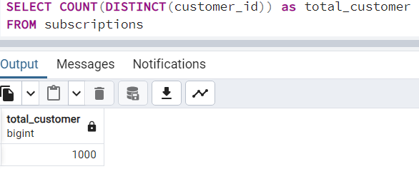
B. Data Analysis Questions 1. How many customers has Foodie-Fi ever had?

Slide 6
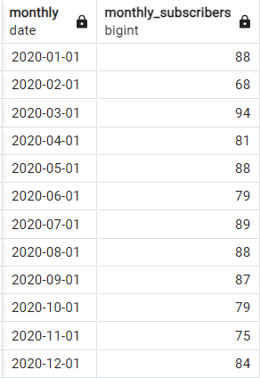
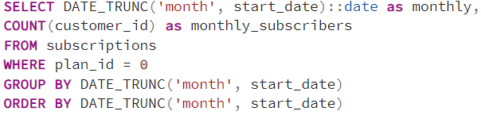
2. What is the monthly distribution of trial plan start_date values for our dataset use the start of the month as the group by value

Slide 7
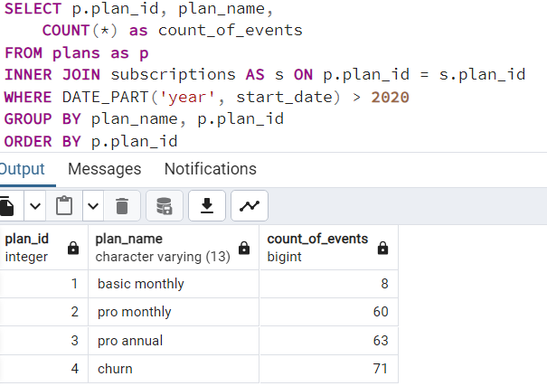
3. What plan start_date values occur after the year 2020 for our dataset? -- Show the breakdown by count of events for each plan_name

Slide 8
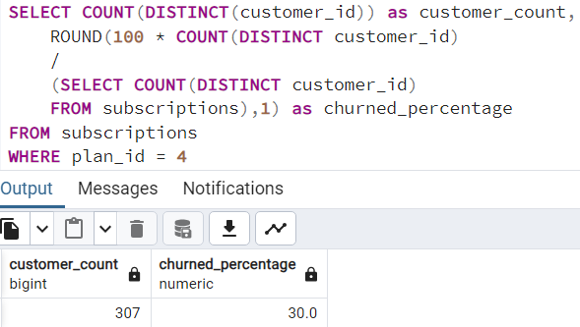
4. What is the customer count and percentage of customers who have churned rounded to 1 decimal place?

Slide 9
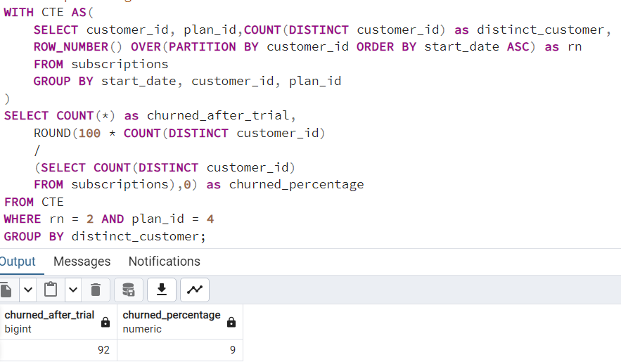
5. How many customers have churned straight after their initial free trial what percentage is this rounded to the nearest whole number?

Slide 10
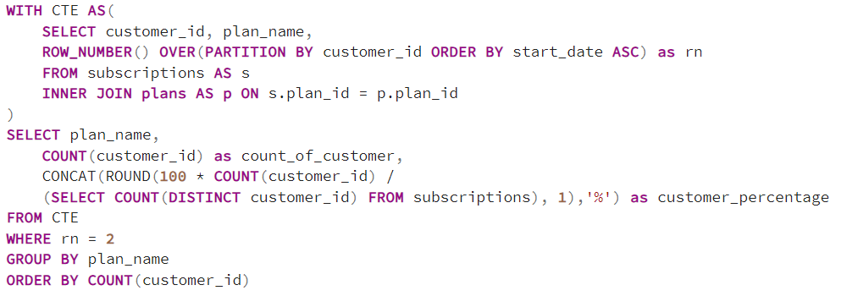
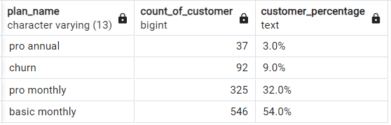
6. What is the number and percentage of customer plans after their initial free trial?

Slide 11
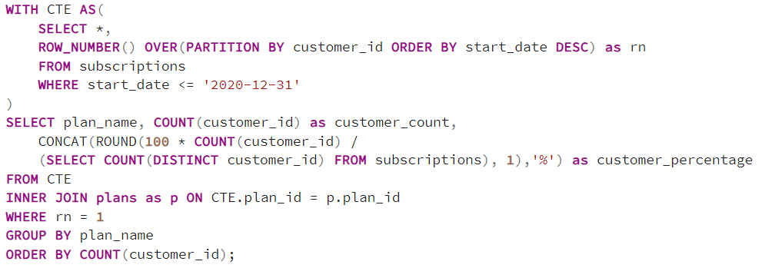
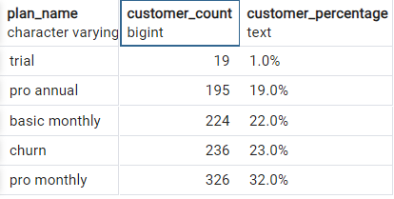
7. What is the customer count and percentage breakdown of all 5 plan_name values at 2020-12-31?

Slide 12
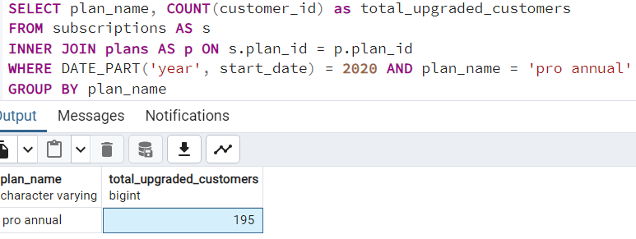
8. How many customers have upgraded to an annual plan in 2020?

Slide 13
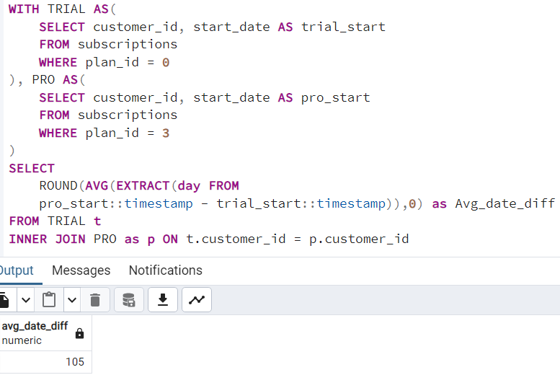
9. How many days on average does it take for a customer to an annual plan from the day they join Foodie-Fi?

Slide 14
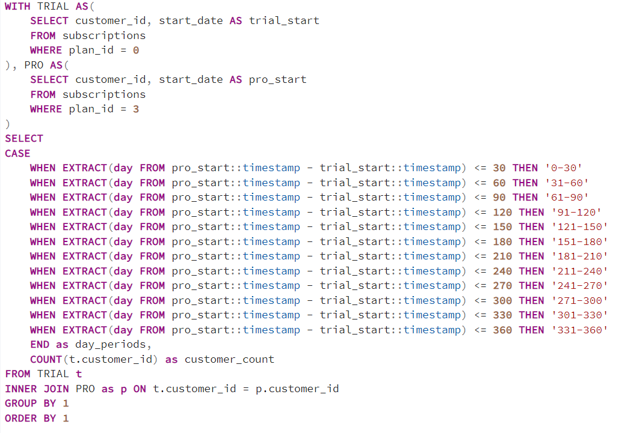
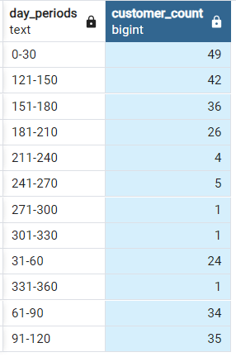
10. Can you further breakdown this average value into 30 day periods (i.e. 0-30 days, 31-60 days etc)

Slide 15
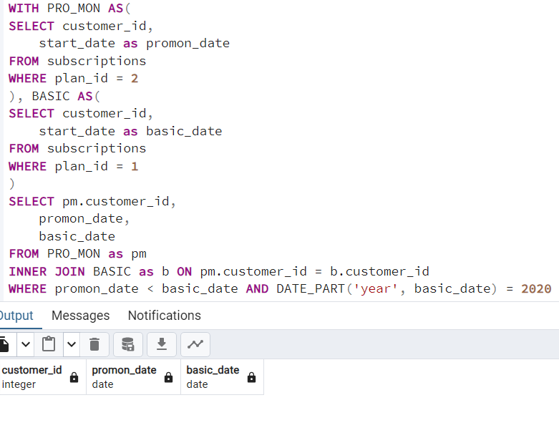
11. How many customers downgraded from a pro monthly to a basic monthly plan in 2020?
No one Downgraded from Pro Monthly to Basic Monthly plan in 2020.

